Slide 1
Managing Your Housing Portfolio for Success
Finance 101 for the On-Reserve Non-Profit Housing Program (Section 95)

Slide 2
Reporting Requirements:
Revenue, Expenses, Operating Reserve and Replacement Reserve

Slide 3
Revenue

Slide 4

Revenue: Pre-97 program requirements
First Nation should operate at a break-even position (rent + band contribution + subsidy = expenses)
Where rent-geared-to-income (RGI) is being used, auditor to confirm the process was followed
Rental increases should be implemented
Notes:
To manage the Program successfully, the First Nation should be collecting revenue contributions from tenants and/or contributing sufficient revenue to meet Program expenses when combined with Program subsidies.
Where tenants are charged rent based on income, the auditor is asked to provide verification in his report that the rent-to-income scale has been applied.
First Nations are required to increase their rents annually by the Consumer Price Index or an amount they deem sufficient to ensure all project operating expenses are covered, whichever is greater.

Slide 5
Revenue—Pre-97 Program
Revenue sources:
    Rental revenue
    Section 95 subsidy
    Interest income
    First Nation contribution
A revenue contribution must be made to projects in deficit.
When expenses exceed revenues, and First Nations do not have sufficient revenues to cover future expenses, the project’s viability and the ability to maintain units at minimum level of health and safety are at risk.
Notes:
Oftentimes, we note that expenses are being paid by First Nations, but there is no indication of the contribution as revenue.
In many cases, expenses exceed revenue, and First Nations are not contributing additional resources to ensure the project remains viable.
Impact
Deficits are reported on the financial statements, indicating projects are not viable
Insufficient revenue will prevent the community from having the financial resources to maintain the units and to plan for future expenses.

Slide 6
Audited Statement- Example (Pre-97)
Revenues | Example | Corrected version
Rental revenue | 50,000 | 50,000
CMHC Subsidy | 58,200 | 58,200
Band Contribution |  | 16,815
Total Revenue | 108,200 | 125,015
Expenses
Administration | 6,540 | 6,540
Maintenance | 12,400 | 12,400
Insurance | 7,875 | 7,875
Audit | 3,100 | 3,100
Mortgage interest | 62,884 | 62,884
Amortization | 15,716 | 15,716
Replacement Reserve Allocation | 15,000 | 15,000
Services | 1,500 | 1,500
Total Expenses | 125,015 | 125,015
Current year surplus / (deficit) | -16,815 | 0
Surplus / (Deficit) at beginning of year | (64,218) | 0
Surplus / (Deficit) at end of year | (81,033) | 0
In this example, the Band Contribution was listed as an expense, when it is actually a source of revenue. It does not represent a deficit.

Slide 7
Revenue—Post-96: Minimum Revenue Contribution
The Section 95 operating agreement requires that the First Nation contribute a set amount annually, known as the minimum revenue contribution (MRC)
This amount is identified and agreed to at the time the project is committed
The agreement does not prescribe the source of the revenue—it could come from an occupancy charge, a First Nation contribution or both.
Notes:
For the Post-1996 Program, the community’s revenue contribution can be a combination of rents collected from tenants and band funds equal to or greater than the minimum revenue contribution (MRC) that was established at delivery.
The First Nation has agreed to fund the MRC on an annual basis if occupancy charges are less than the MRC. CMHC expects to see an operating surplus for the first half of the agreement as expenses are benchmarked.

Slide 8
Importance of the Minimum Revenue Contribution
When the MRC is not being funded as per the operating agreement, the impact is insufficient revenue to cover expenses. This threatens project viability and the ability to maintain a project at a minimum level of health and safety.
When expenses exceed revenue and are being paid by the band, this must be recorded as a revenue contribution, and not as a liability (loan). Otherwise, statements will reflect an ongoing deficit.
Tip: When reviewing your draft audit, ensure rental revenue and other revenue equals MRC. If not, ensure a band contribution is recorded.
Notes:
In many cases:
Rental revenue is not sufficient to match MRC, and expenses are being paid by First Nations, but no indication of the contribution as revenue.
Band contributions are showing as a liability and repayable to the band. This is not a contribution, but a loan, and the terms of the agreement are therefore not being met.
Impact
Deficits are reported on the financial statements, indicating projects are not viable.
Insufficient revenue will prevent the community from having the financial resources to maintain the units and to plan for future expenses as operating costs rise.
No surplus generated in early years to cover future deficits.

Slide 9
Reasons why the MRC is not funded / underfunded
Vacant units during the year. For example, if a unit is vacant for 2 months, the First Nation must contribute the MRC for those 2 months.
Occupancy charge is lower than MRC. (ex: charge is $300, MRC is $400). The First Nation must then contribute the difference each month to meet the MRC requirement.
The First Nation is using cash-basis accounting—recognizing revenue only when it is paid, instead of when it is earned (accrual)

Slide 10
Audited Statement- Example (Post 96)
Minimum Revenue Contribution | 75,000 | 75,000
Revenues | Example | Corrected Version
Rental Revenue | 50,000 | 50,000
CMHC Subsidy | 58,200 | 58,200
Band Contribution | 0 | 25,000
Total Revenue | 108,200 | 133,200
Expenses
Administration | 6,540 | 6,540
Maintenance | 12,400 | 12,400
Insurance | 7,875 | 7,875
Audit | 3,100 | 3,100
Mortgage interest | 62,884 | 62,884
Amortization | 15,716 | 15,716
Replacement Reserve Allocation | 15,000 | 15,000
Services | 1,500 | 1,500
Total Expenses | 125,015 | 125,015
Current year surplus / (deficit) | -16,815 | 8,185
Surplus / (Deficit) at beginning of year | 12,500 | 0
Surplus / (Deficit) at end of year | (4,315) | 20,685

Slide 11
Expenses

Slide 12
Expenses
Fire Insurance
Repairs/Maintenance
Heat/Hot Water
Water/Sewer
Administration
Replacement Reserve
Loan Payments
Snow Removal/Garbage Collection
Audit/Legal Fees
Notes:
Expenses reported should only be attributable to the Section 95 units
In most cases, housing department manages a lot of housing that has been funded through means other than the Section 95 program. It is important that all administrative costs—staffing, audits, maintenance, insurance, etc. be attributed only to the applicable units. When the audit reports on the Section 95-funded units, these costs must be appropriately apportioned. The same property management policies around reserves and management can, and certainly should, apply to all units—these are standard property management practices, and this, again, ensures equity and transparency for all tenants and community members.

Slide 13
Bad debts
Post-96 Program
  Bad debt is not considered an eligible program expense given the requirement for the First Nation to contribute the MRC.
Pre-97 Program
  Bad debt can be recognized, as long as in compliance with CMHC’s guidelines & criteria
Bad debts expense
Rental arrears should not be recorded as bad debts if the tenant still resides in the unit. There should be an arrears policy and collection process to seek payment of arrears.

Slide 14
Operating Reserve Fund (post 96)

Slide 15
Operating Reserve Fund - Post-96 Program
The program is designed to generate surpluses in the early years that are to be held in an operating reserve fund.
This surplus will be available to offset higher operating costs that are expected as the project ages.
The surplus is invested in a separate interest-bearing account and treated as a restricted account.
This reserve is for the housing program and the funds are not returned to CMHC.
Notes:
As required by the project’s operating agreement, surpluses should be invested (directed) to a separate operating reserve fund, which is the community’s reserve for specifically these units. This reserve must be held securely to cover future needs.
Why the reserve is important:
Operating expenses are “benchmarked” at time of commitment for the full loan amortization period—these costs to operate are forecasted forward approximately 15 years.
What this means is that, in the early years of operating the housing, costs should be lower (new homes, minimal maintenance work) and surpluses should be generated that are retained in interest-bearing accounts for future years (operating reserve account).
Higher operating costs could include:
increased maintenance expenses
increased insurance expenses
higher administration costs
increased professional fees

Slide 16
Impact of Unfunded Operating Reserve
No money to offset future rising operating costs expected as the project ages.
If reserves are not established and accumulating in the early years, and revenues do not increase at a steady rate, the community will not have the ability to maintain the houses as costs rise.
This threatens the future viability of a project and the ability to maintain the project at a minimum level of health and safety.
Notes:
What are we seeing?
Reserves are not identified in a separate account, or are not funded at all.
Impact
If reserves are not established and accumulating in the early years, and revenues do not increase at a steady rate, the community will not have the ability to maintain the houses as costs rise (again, the housing is no longer self-sustaining). This reserve is again for the housing program, and the funds are not returned to CMHC.

Slide 17
Audited Statements - Operating Reserve
Operating Reserve | Unfunded | Funded
Opening balance | $15,000 | $15,000
Interest earned | $0 | $500
Current year surplus / (deficit) | $1,500 | $1,500
Closing balance | $16,500 | $17,000
Funded bank account | $0 | $17,000
Reserve overfunded/(underfunded) | ($16,500) | $0

Slide 18
Replacement Reserve Fund

Slide 19
Replacement Reserve Fund
A replacement reserve is to be held and funded in a separate interest-bearing account.
It should be used as intended: to pay for the replacement of worn-out building components or for major repairs.
Under the Post-96 Program, prior approval from CMHC is not required. Under the Pre-97 Program, use of the replacement reserve requires prior approval from CMHC. However, this prior approval can be waived if a community has a capital expenditure plan in place.
Notes:
The First Nation can choose to increase the replacement reserve allocation, but this increase needs to be pre-approved by CMHC.
Why is it important:
It is important to fund the replacement reserve because it assists in funding future capital replacement items such as roofs, flooring, heating systems, hot water tanks, appliances, etc.
This is, again, like an insurance policy for the community—the key difference is that it is retained and managed by the community housing operations. As buildings age, so do their major components—roofs need to be repaired, furnaces need to be replaced.
Establishing a replacement reserve fund is a standard business practice to protect against future costs. Building up financial resources right from the start of operations ensures funds will be available when you need them later on—it also ensures the community will not have to borrow funds or take funds from community resources to sustain their housing portfolio.
Again, these funds belong to the housing operations. They do not need to be returned to CMHC.

Slide 20
Impact of Unfunded or Underfunded Replacement Reserves
    No funds to pay for expensive and/or urgent capital repairs, which may put tenants and units at risk
    No funds available to extend the useful life of homes
    CMHC Section 95 homes are not eligible for other assistance (ex: RRAP)
Notes:
What we see:
Accounts underfunded, or not funded at all.
Impact:
Impact of not having the pool of funds is significant. When an inspection uncovers an urgent need to address major components and there are no funds available, the required work does not get done—this can put the occupants and units at risk.
Not funding the replacement reserve is a violation of the operating agreement, threatening future project allocations.
The replacement reserve is similar to a pension plan. Setting money aside today to pay for tomorrow’s expenses—in this case, 20 years from now and beyond.

Slide 21
Maturing units- reporting adjustments
As units mature / agreements end, adjustments need to be made to ensure that the financial position reported is reflective of the current portfolio.
CMHC will provide details of adjustments in the audit call letter.

Slide 22
Financial Reporting Process

Slide 23
The Audit Package
  Audited financial statements are due four months from the fiscal year end. (In most cases, this is four months from March 31, which is July 31.)
  CMHC will send an “Audit Call Package,” which contains:
      financial data for your housing portfolio
      resources and information to assist you and clarify audit expectations
      the Here’s Help With Your Financial Statement information guide
Notes:
Shortly after the fiscal year end, CMHC provides First Nations with an “audit call letter.” This will provide a reminder of deadlines, program requirements and financial information necessary to complete the audit and resources to assist with the preparation of the audit. You will be provided with the subsidy disbursements for the year, the expected minimum revenue contribution for the year, and the annual replacement reserve allocation. It is important that all of this information be provided to your auditor. As well, you should receive a statement from your mortgage lender—whether that is CMHC or another lender. This statement will show the payments made during the fiscal year on your mortgage. Again, it is important that your auditor receive this information.
This presentation will provide an overview of what the completed audit submission should include and help clarify aspects of the financial reporting process, as required by CMHC.

Slide 24
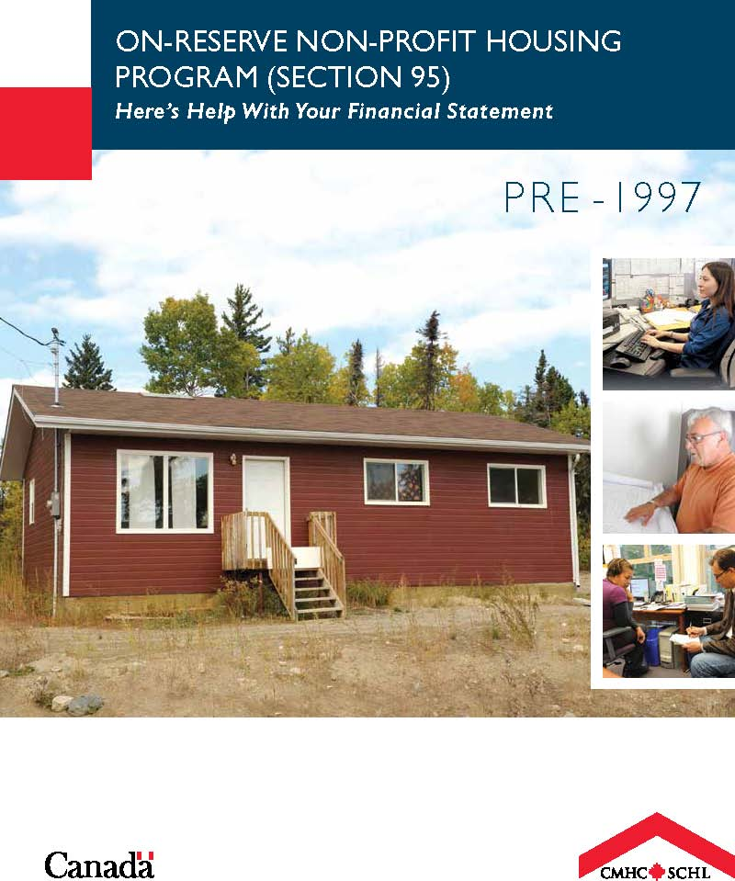
Here’s Help with your Financial Statement guides
Notes:
These are the guides you need to be aware of when completing financial reporting. The guides speak to each program and outline clearly the reporting requirements. We are going to look at some of the areas where we find the expectations may not be clear and look at why certain requirements are important to not only CMHC, but also to the communities.
Many First Nations across Canada use one or both of the Section 95 programs. There are two distinct programs that are under administration, the first is the PRE-1997 Program and the other is the POST-1996 Program. The Pre-1997 Program remains under administration; however, new units are no longer being delivered under these guidelines. The Post-1996 Program continues to be delivered to First Nations by CMHC—it is important to remember these are two distinct programs, with different reporting requirements, and CMHC therefore requires a set of financial statements for each.

Slide 25
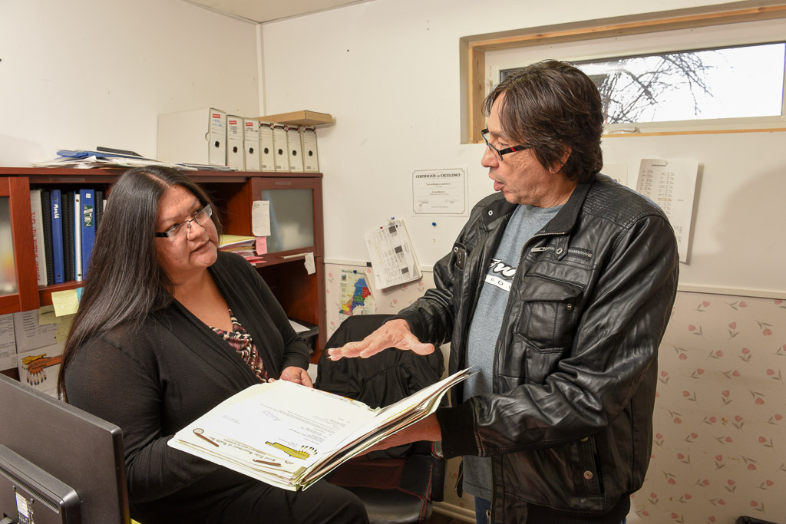
What to include in the Audit Package
  Auditor’s Report
  Statement of Financial Position (Balance Sheet)
  Statement of Revenue and Expenses (Income Statement)
  Statement of Cash Flow
  Statement of Funded Reserves (Replacement Reserve, Subsidy Surplus Fund (Pre-1997) and Operating Reserve (Post-1996))
  Notes to the Financial Statements
  Auditor’s Report on Compliance with the Agreement
Notes:
Occasionally, we get some communities or their auditors asking why they need to provide a separate statement for housing. The Program is intended to be self-sustaining—in other words, the revenues received should fully support the long-term operations of the housing. In order to clearly identify the operations, there needs to be clear reporting on both the revenue and the expenses for the year. This is also very important information for communities to see clearly what housing costs and to be able to see what it costs a community when tenants choose not to pay their rent.

Slide 26

Thank You
.
To be filled in by CMHC staff – contact info, etc.

