Slide 1
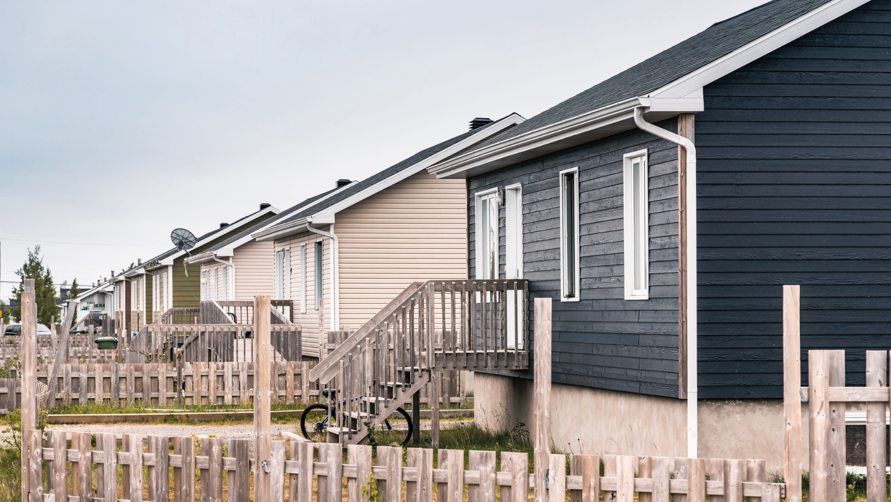
Regional Housing Meeting November 21st, 2023
A project developed by

Slide 2
Looking back: Preparing the ground
Report presented by the First Nations of Quebec and Labrador Economic Development Commission to the Tripartite Regional Housing Committee in June 2020
To "pave the way" for a new way of funding a range of First Nations housing solutions
Innovative financing solutions to support a housing catch-up project for First Nations in Quebec and Labrador

Slide 3
A few observations…
Housing…
Insufficient housing supply
Overcrowded, prematurely worn-out housing
Necessary renovations and decontamination
Public and private funding insufficient to meet current and future needs
Local governments with limited debt capacity
Insufficient space
Insufficient infrastructure

Slide 4
Some possible solutions…
Document the financial situation and provide support to lay the foundations for change
Present the relevant financial tools and the conditions for using them
Financial literacy and housing clinic

Slide 5
Since our last meeting…
Winter 2023
Project launch
Spring 2023
Preparation of financial literacy workshops and individual coaching
Summer 2023
Start of financial literacy and housing workshops and community visits
Fall 2023
Launch of the Manikaso Centre

Slide 6
Official launch…
Means « the one who builds » in Atikamekw..
Building a financial future…
Building a home…
Website: manikaso.com
Facebook: Manikaso

Slide 7
Workshops
Available
Upcoming
Keeping track of my expenses
Starting a budget
Understanding credit
Home building process
Raising awareness of financial exploitation (seniors)
Financial literacy awareness (entrepreneurial component)
Indebtedness
Savings
Down payment
Housing needs
Mold prevention

Slide 8
Keep track of my expenses
Workshop objectives:
Be aware of your expenses
Budgeting skills
Good management of personal finances

Slide 9
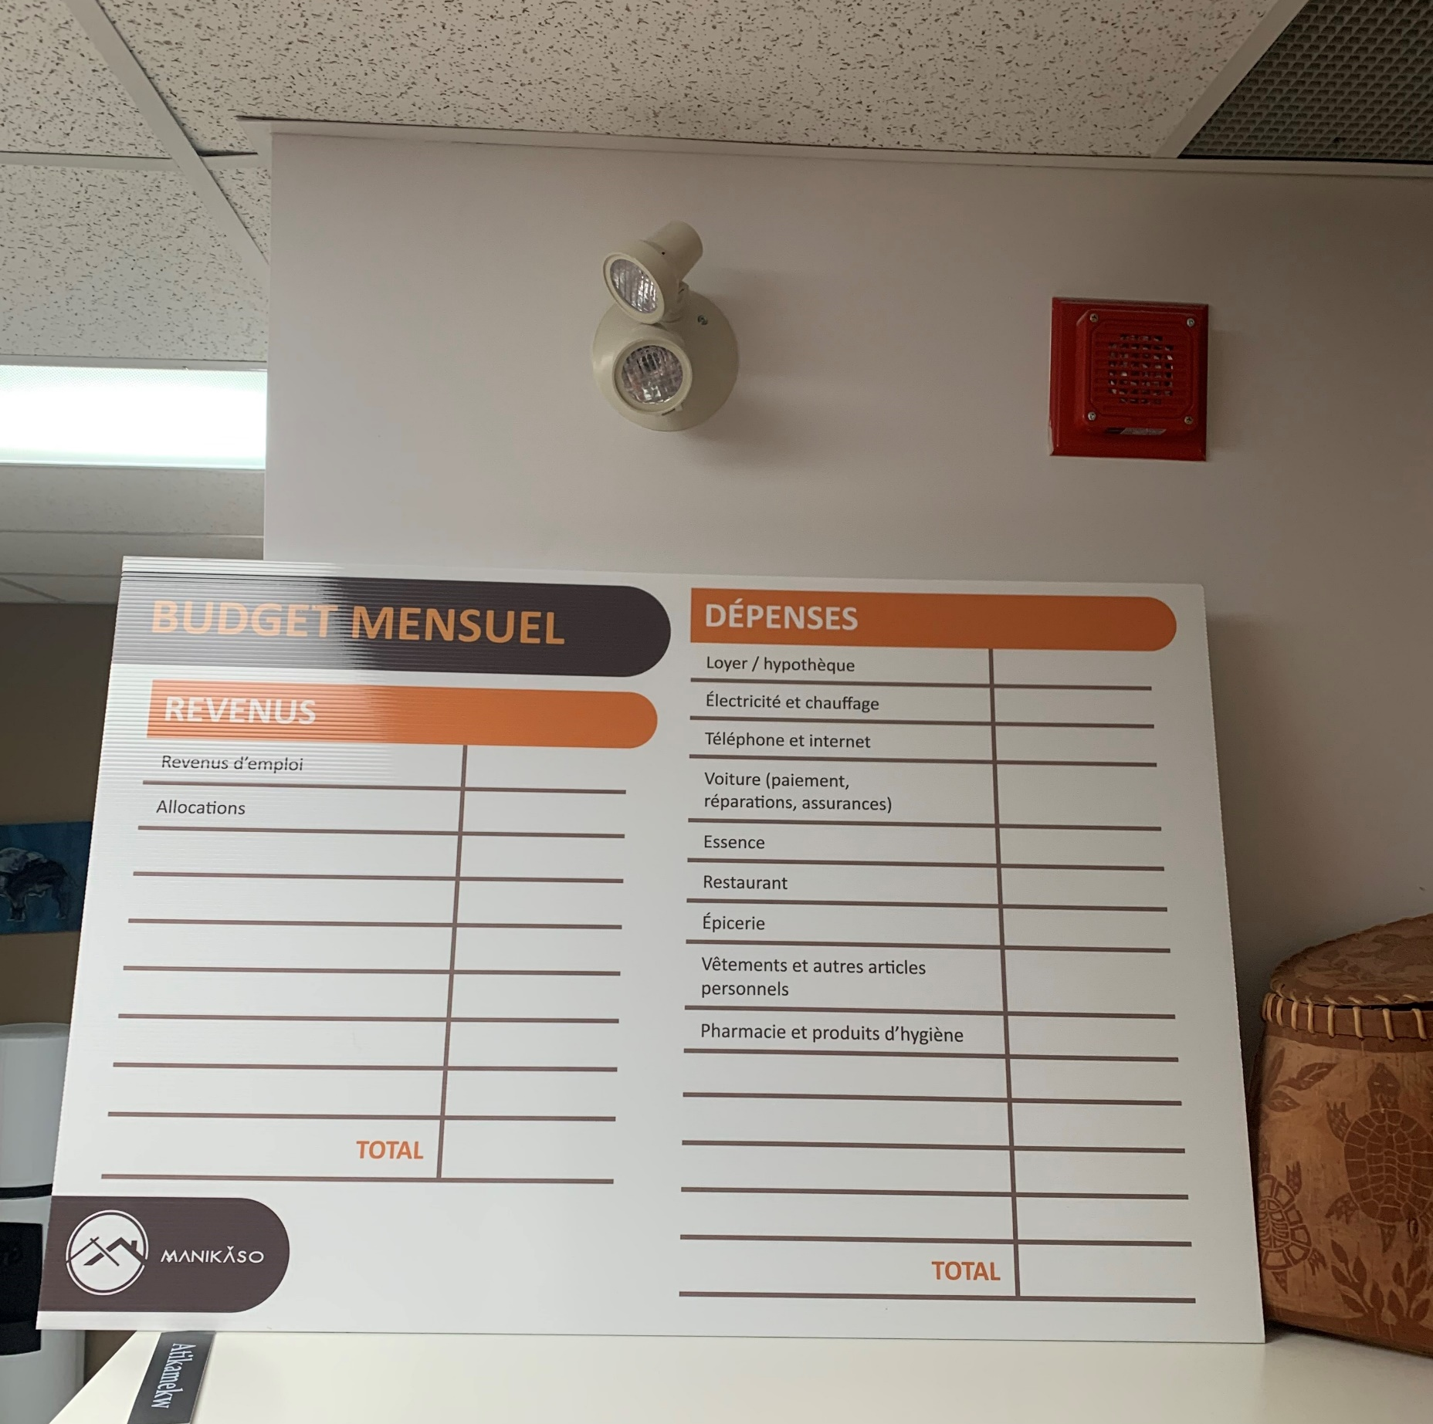
Starting a budget
Workshop objectives:
Draw up an initial outline of your monthly income and expenses
Realize that everyday choices influence your finances
Encourage participants to complete the portrait of their expenses with specific information

Slide 10
Understanding credit
Workshop objectives:
Understanding how a credit rating works
Building or correcting a credit score
Have power over the credit score

Slide 11
Home building process
Workshop objectives:
Introducing the main steps to building your own home
Participants have a clear picture of their next step in the realization of their project

Slide 12
Raising awareness of financial exploitation (seniors)
Workshop objectives:
Understanding financial exploitation
Recognizing warning signals
Know how to prevent it

Slide 13
Financial literacy awareness (entrepreneurial component)
Workshop objectives:
Entrepreneurship is a professional marathon that demands a certain level of personal financial health on the part of the future entrepreneur.
Take the following points into consideration before getting started:
Down payment
Credit
indebtedness

Slide 14
Target clienteles
Tenants or owners
Young families
High schools
Family houses
Community houses
Future entrepreneurs
All First Nations members

Slide 15
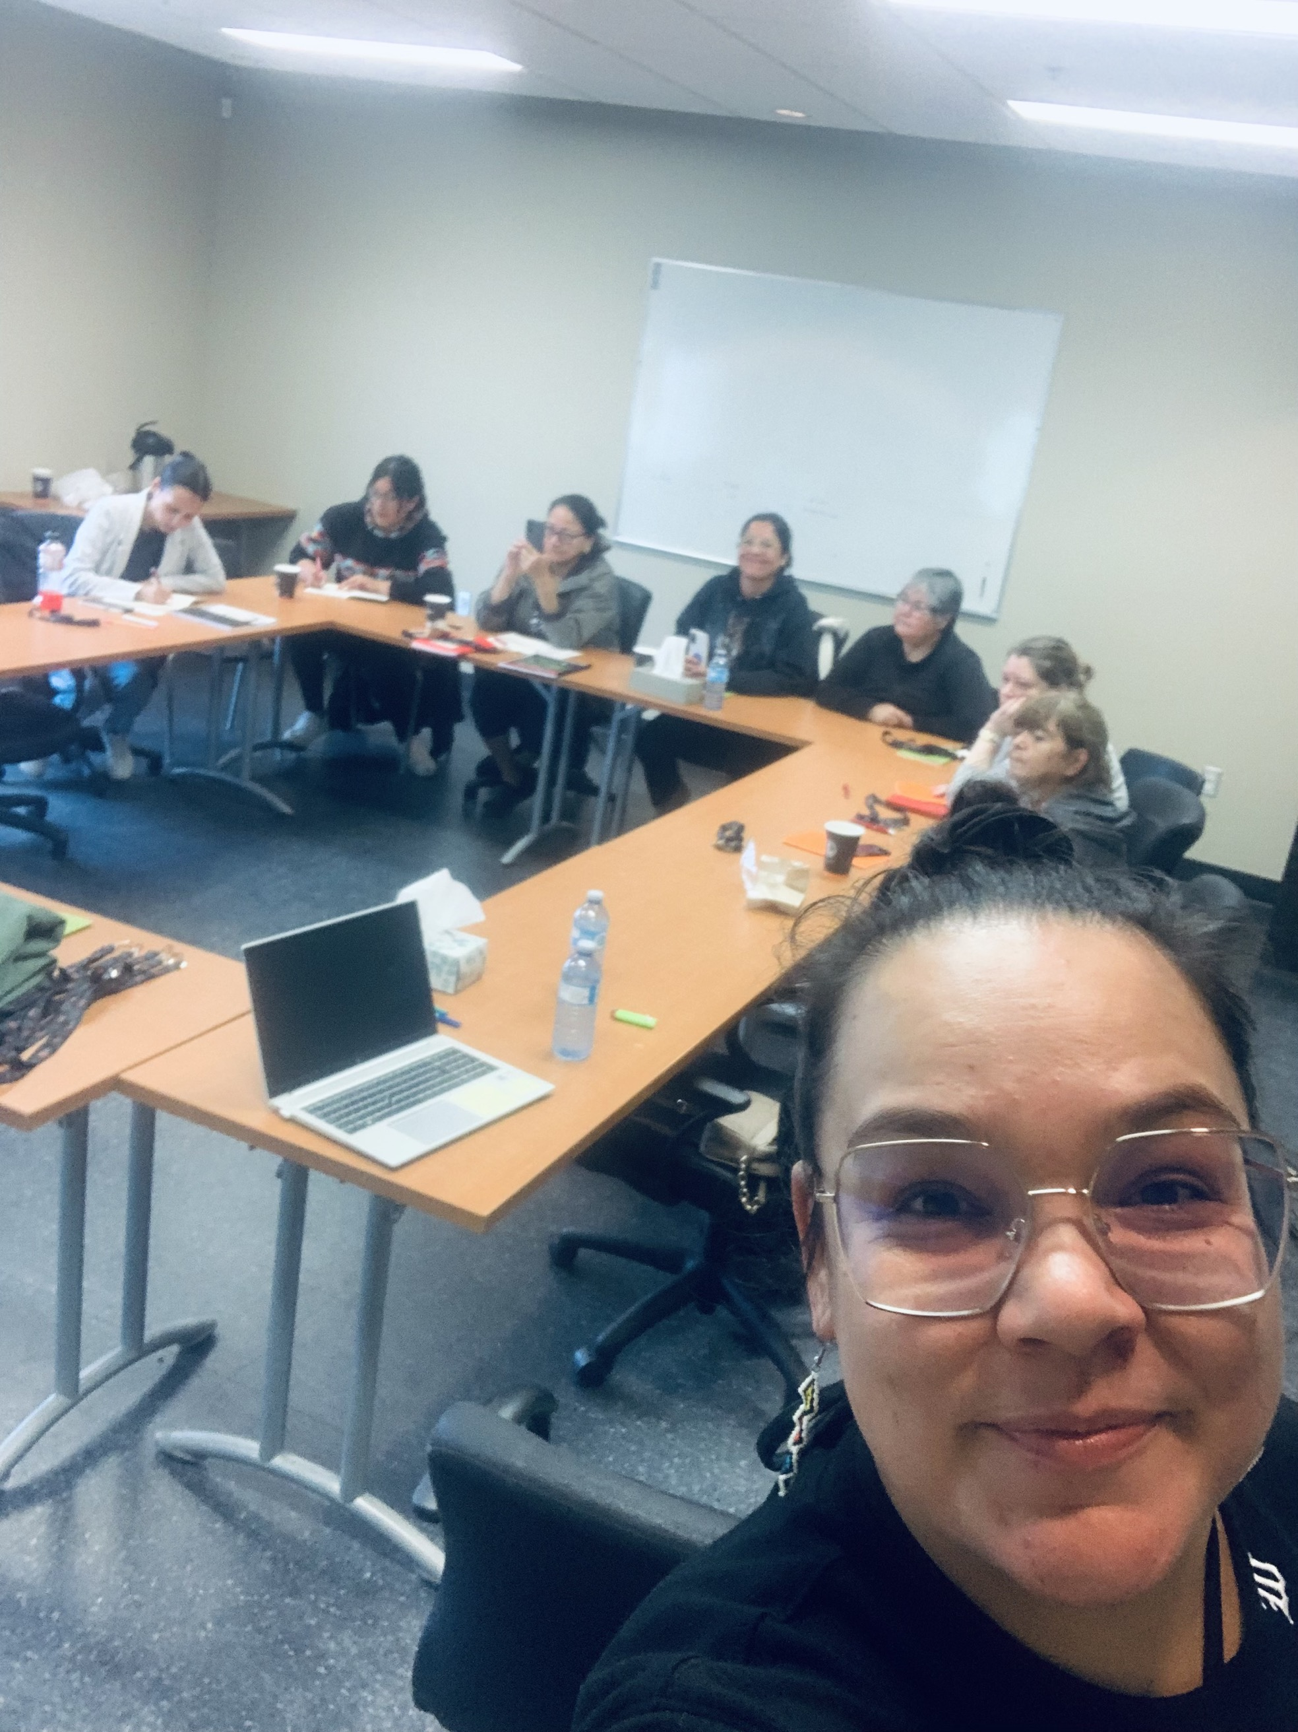
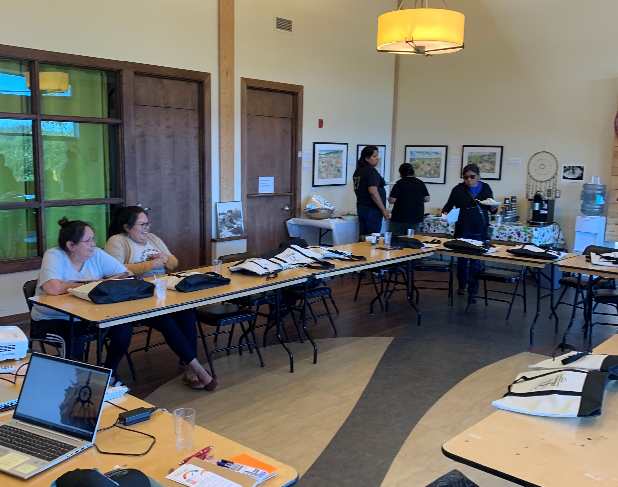
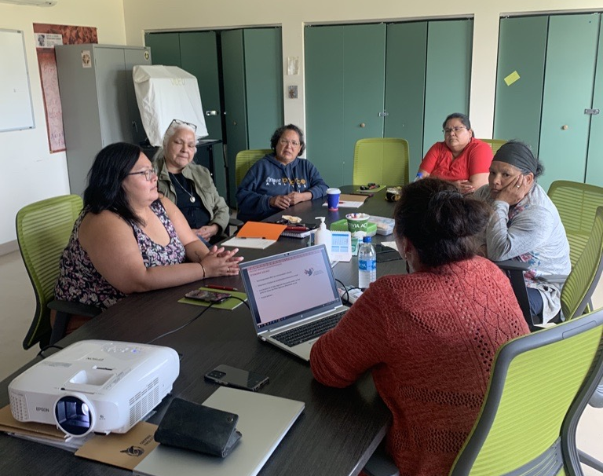
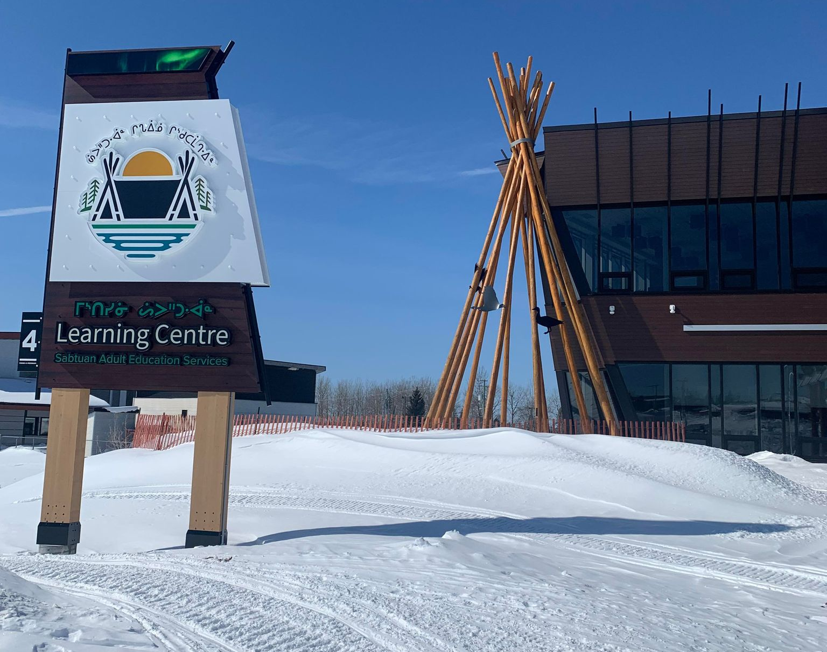
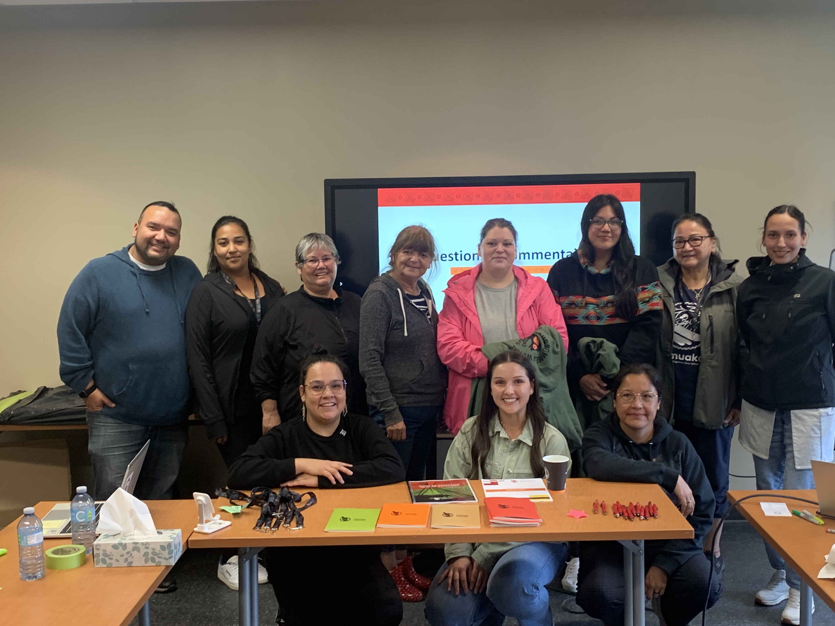
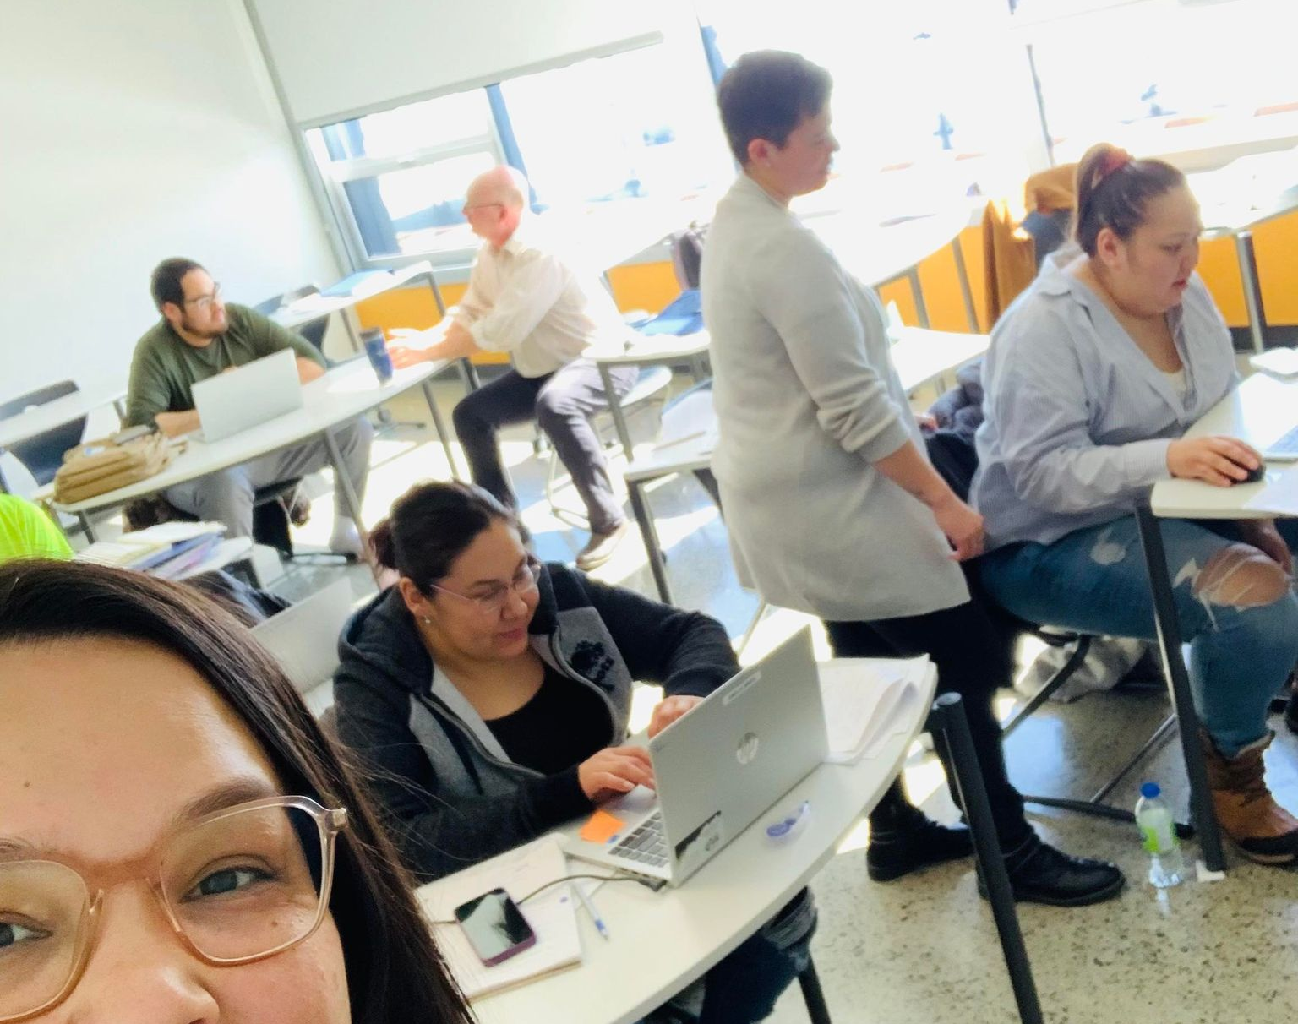
Manikaso in pictures…

Slide 16
Participatory workshops
Keeping track of your expenses: Who would like to participate?
We need 6 to 8 participants

Slide 17
Questions? Comments?
Mish-Shannda Bastien-Pilot
Housing and financial literacy officer
mbastien@cdepnql.org
418-843-1488, x 1235
manikaso.com

