Slide 2
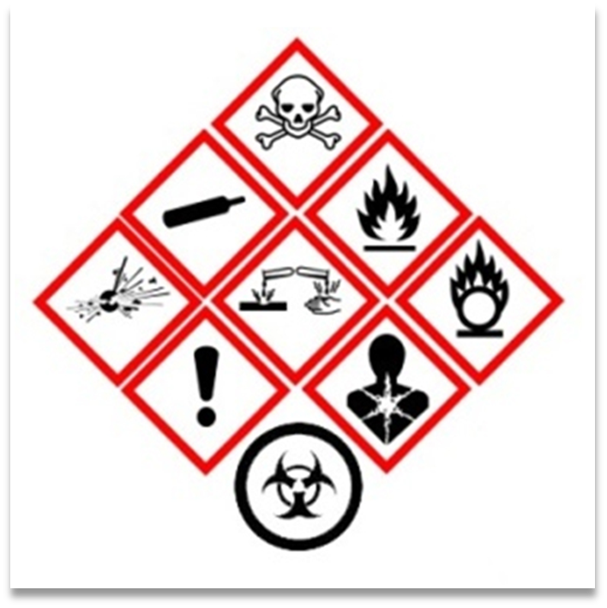
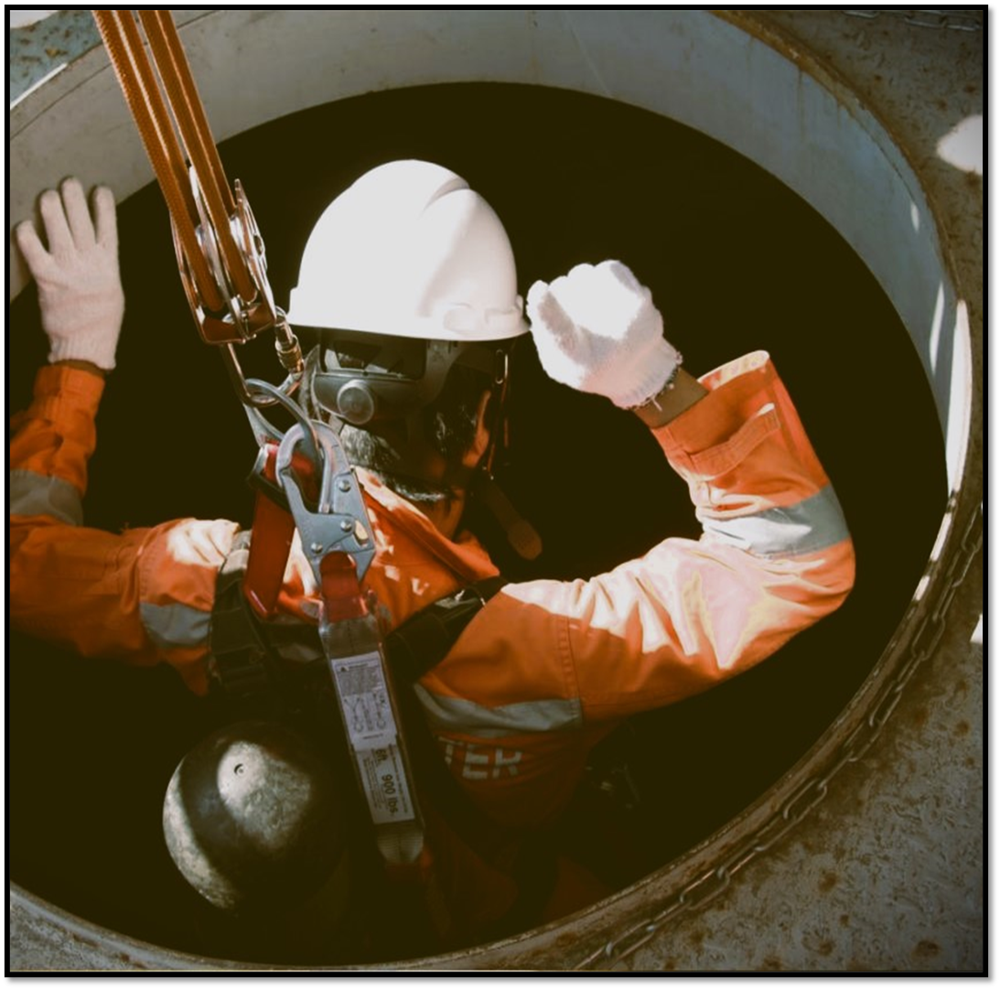
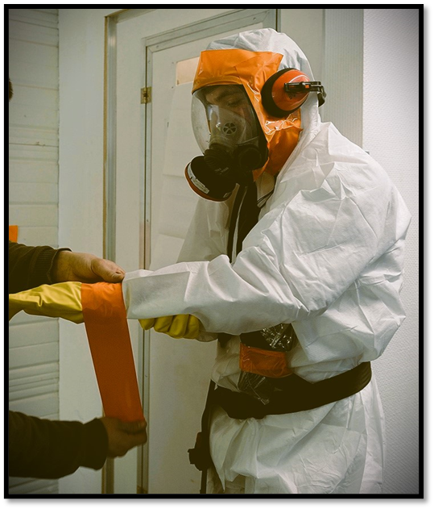
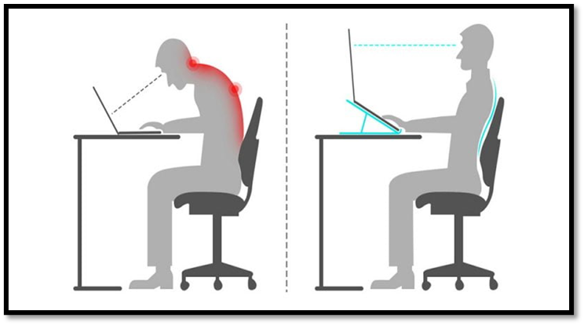
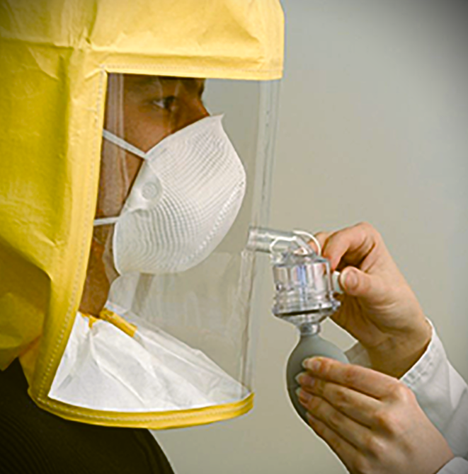
Pilot Project on Health and Safety at Work

Slide 3
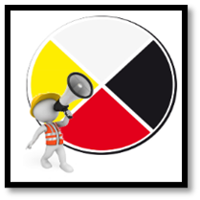
Our goal
Provide a comprehensive support service in the field of health and safety at work.
Supply all the necessary tools for implementing safe work procedures and assist you in developing habits to identify all risks and hazards related to your work environment.
Target health and safety issues and challenges and assist you in implementing corrective measures.
Train your workers on the secure management of the nature of the tasks to be carried out.
Keep you informed about new standards and regulations in force.

Slide 4
The training: a first step towards taking charge of occupational health and safety (OHS)
The training of your workers represents a crucial initial step towards taking responsibility for health and safety in the workplace, and W8banaki can assist you in this regard.
If your workers are well-informed and adequately trained on the various potential risks and hazards associated with their daily work activities, the likelihood of incidents and accidents will be significantly reduced.
Notes:
FORMATIONS DISPONIBLES À CE JOUR :
- Mise en place d’un comité SST
- Travaux en hauteurs (protection contre les chutes)
- Inspecteur d’équipement de protection contre les chutes
- Espaces clos
- Maux de dos et TMS
- Protection respiratoire

Slide 5
Developing tools
As an employer, it is crucial to take all necessary measures to protect the health and safety of your workers, both physically and psychologically.

Slide 6
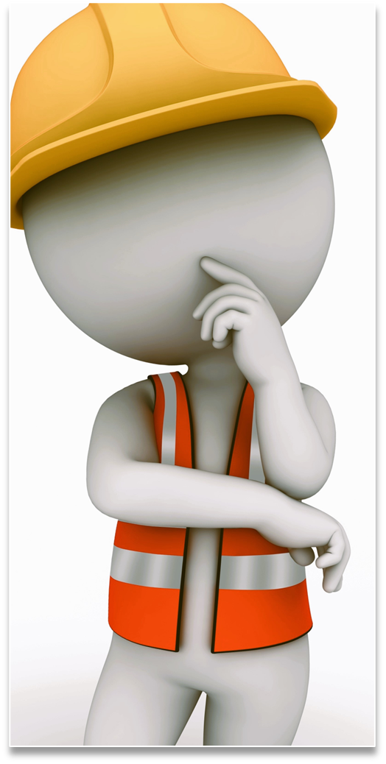
Developing tools
W8banaki has the expertise to assist you in implementing health and safety tools and procedures such as:
Training your workers on various occupational health and safety issues
Creating and developing a prevention program
Establishing an OHS committee
Producing lockout/tagout and confined space entry sheets
Providing training on how to conduct workplace audits effectively
Customizing practical tools for identifying risks and hazards related to your activities, etc.

Slide 10
In conclusion
Our organization believes that occupational health and safety are important, and that all employers and workers should have the necessary tools to:
Ensure that the work environment and organization, as well as the methods and techniques used to accomplish it, are safe.
Take measures to properly identify, control, and eliminate risks, as well as manage hazards.
Inform workers about the risks associated with their work and train them to have the skills and knowledge required to perform their tasks safely.
Ensure not to jeopardize the health, safety, or physical integrity of individuals on or near the workplace premises.

